Slide 2
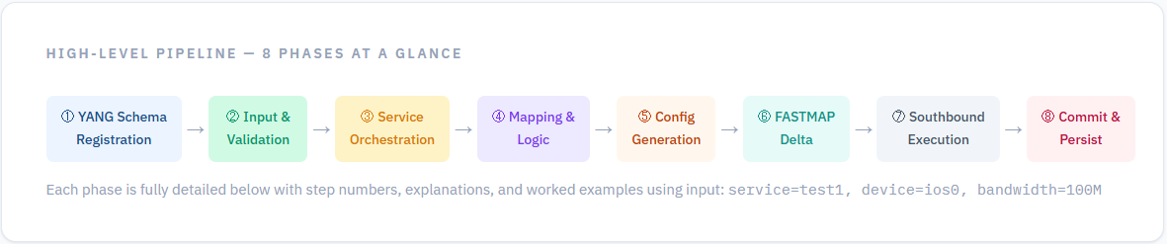
When a network engineer types a single command such as simple-service test1 device ios0 bandwidth 100M, Cisco NSO executes a deterministic 22-step pipeline that validates the request, generates device-specific configuration, computes only what has changed, pushes it to the physical device, and commits everything as an atomic transaction — all within seconds.
This document details every step: what triggers it, what it does, and why it is necessary. The flow is divided into 8 phases — from schema registration through final persistence. Two YANG models drive the entire pipeline: the Service YANG (defines what the engineer can ask for) and the NED YANG (defines the device's native configuration vocabulary).
Service YANG— Defines the service schema (what users can configure: bandwidth, device, service name)
NED YANG— Defines device vocabulary (how Cisco/Huawei config is structured)

Slide 3
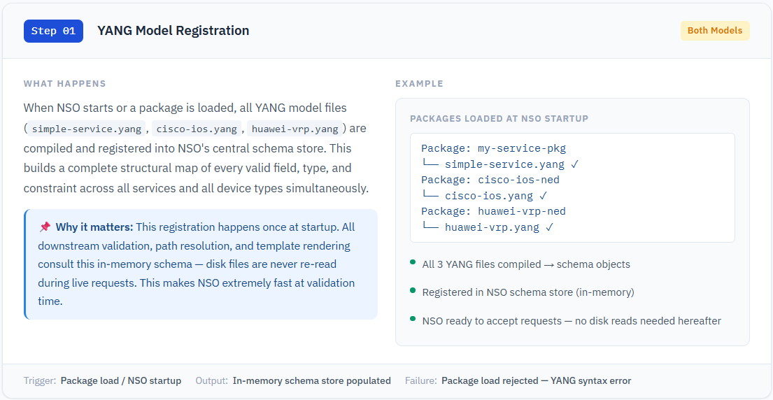
Phase 1 YANG Schema Layer
simple-service.yang file → READ ONCE → compiled → stored in Schema Store (memory) File on disk: packages/simple-service-pkg/src/yang/simple-service.yang ↑ ONLY read here, never again

Slide 4
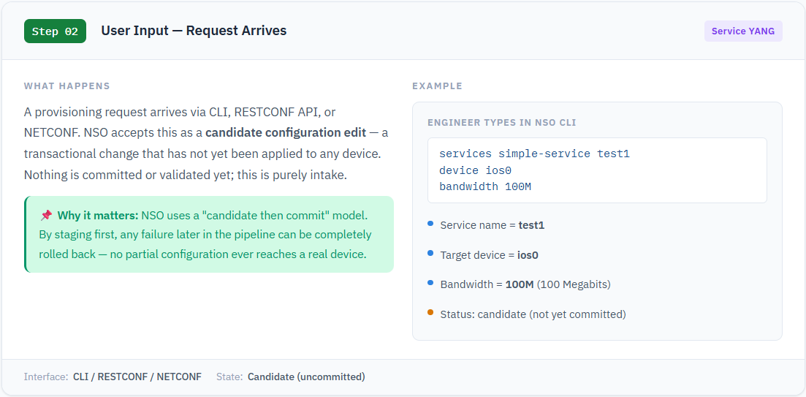
Phase 2 Input & Validation

Slide 5
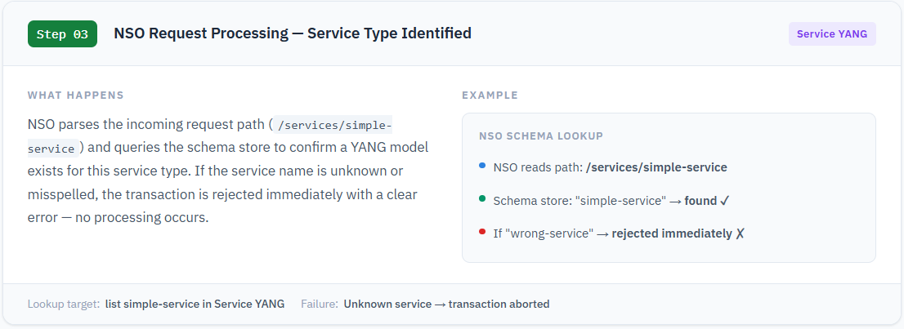
NSO finds .yang file:NSO checks Schema Store in memory (At step 1 stored in memory) — file never touched again except at step 1.(in step 3: loads definations not values device , bandwidth, , speed required and pass to step 4 )

Slide 6
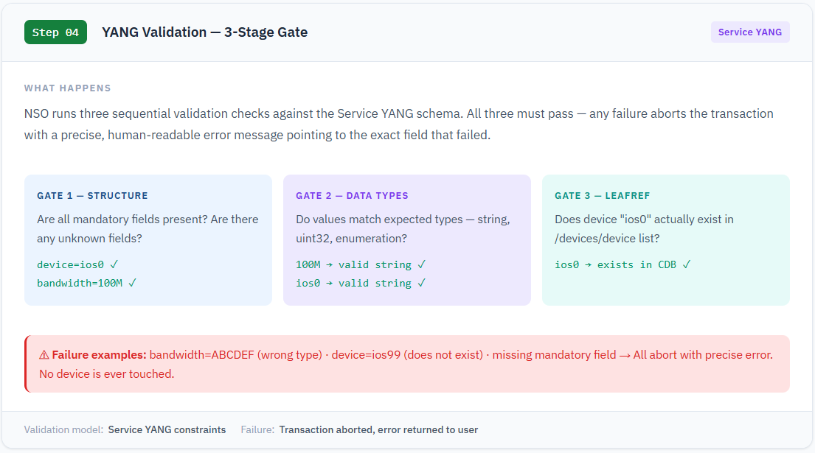

Slide 7
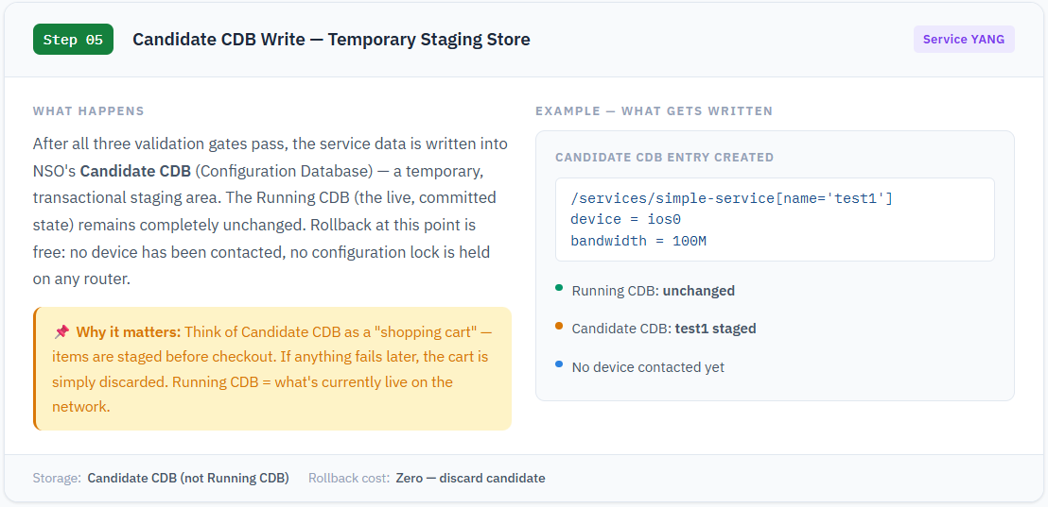

Slide 8
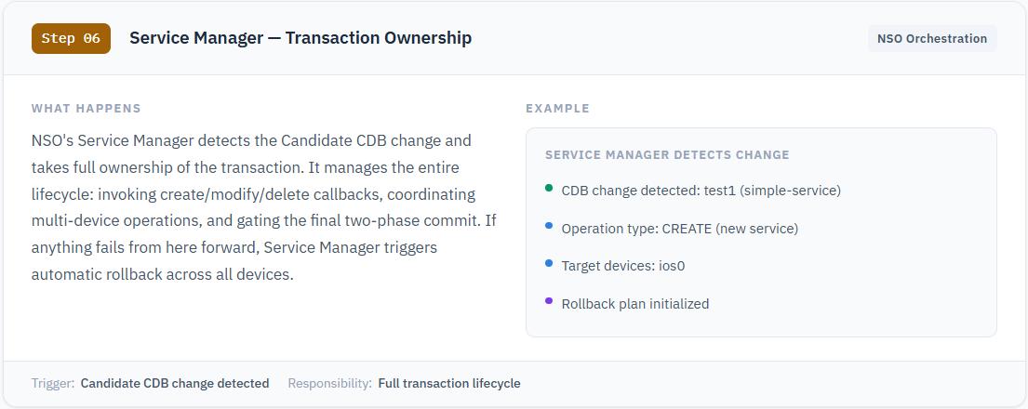
Phase 3 Service Orchestration Steps 6 – 8 NSO takes ownership of the transaction

Slide 9
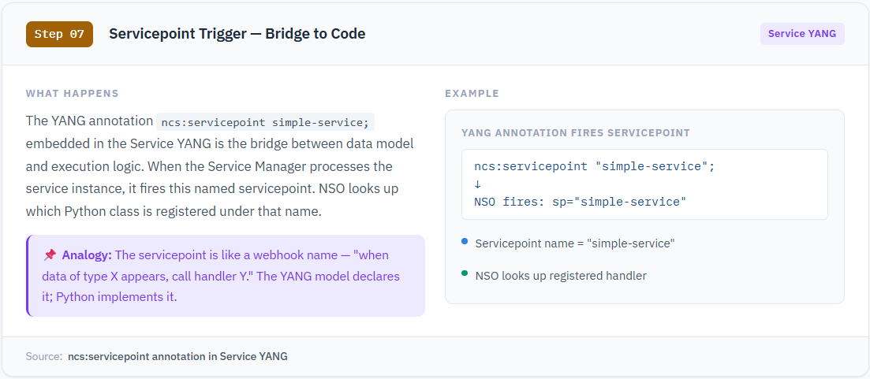

Slide 10
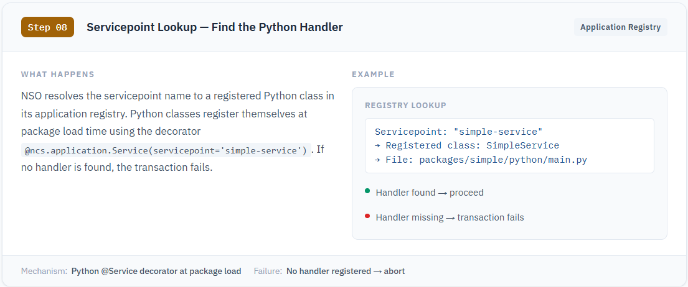

Slide 11
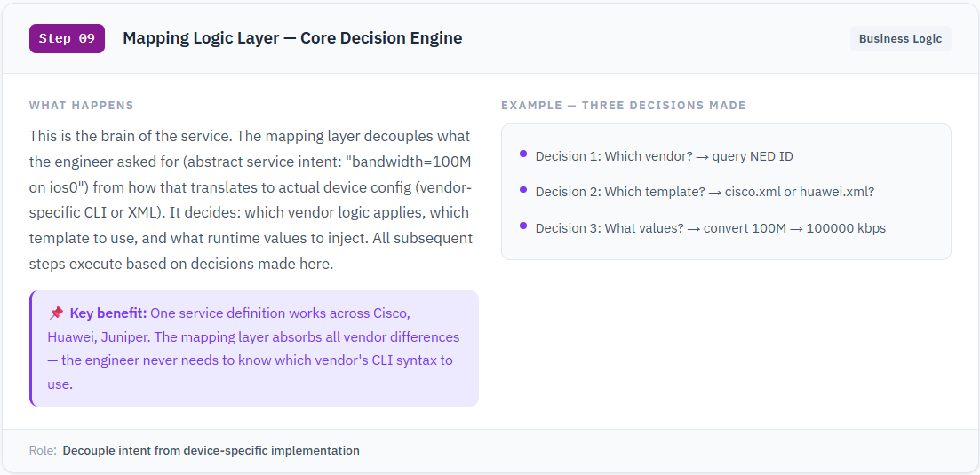
Phase 4 Mapping & Logic Execution Steps 9 – 12 · Business logic, vendor detection, template selection

